Slide 1

Web application to help people reduce plastic consumption
Presented By:
S. M. Shawkat Jamil (1930296)
Komol Karmakar (1930048)
Md. Fahad Khandaker (1930765)
Md. Sadat Kabir Shafin (1921531)
Kazi Sadman Iqbal (2110808)
Rakib Ahmad (2130227)
Simanto Saha (2130220 )
Notes:
Entered text
Web application on helping people reduce plastic consumption

Slide 2
Why do we want to reduce plastic consumption?
Environmental Impact: Plastic pollution harms marine life, causing ingestion and entanglement, and disrupts terrestrial ecosystems.
Climate Change: Plastic production contributes to carbon emissions, relying on fossil fuels and emitting methane in landfills.
Health Concerns: Harmful chemicals in plastics, like phthalates and BPA, can leach into food, posing risks to human health.
Economic Implications: Cleanup costs, impact on tourism, and resource expenditure underscore the economic toll of plastic pollution.
Global Responsibility: International collaboration is essential to address plastic pollution as a global issue, requiring concerted efforts.

Slide 3
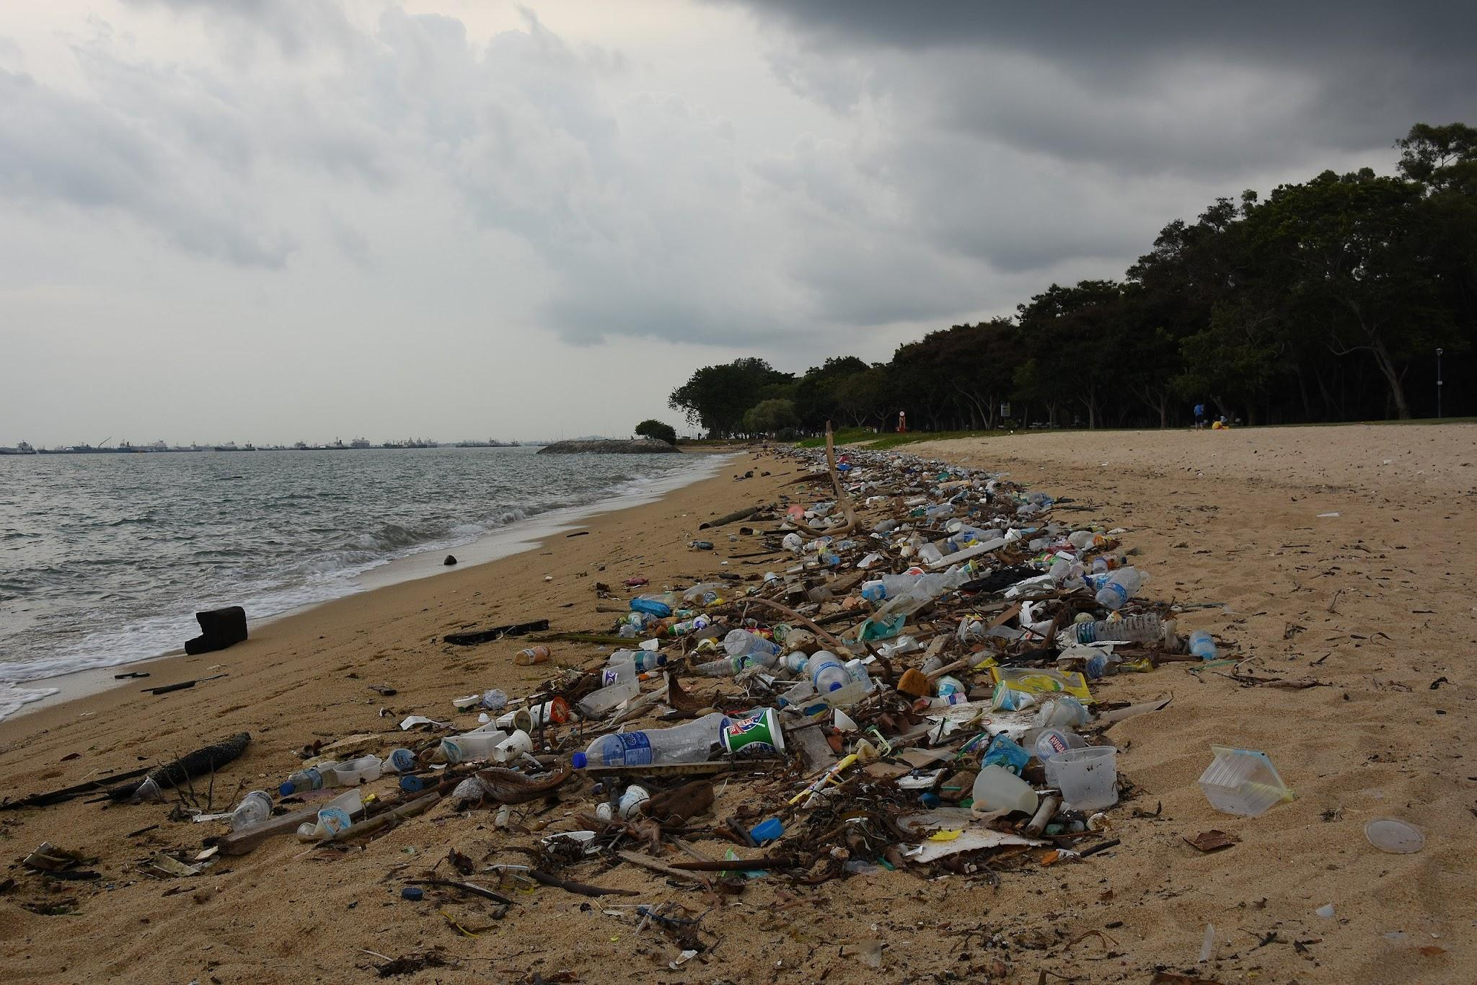
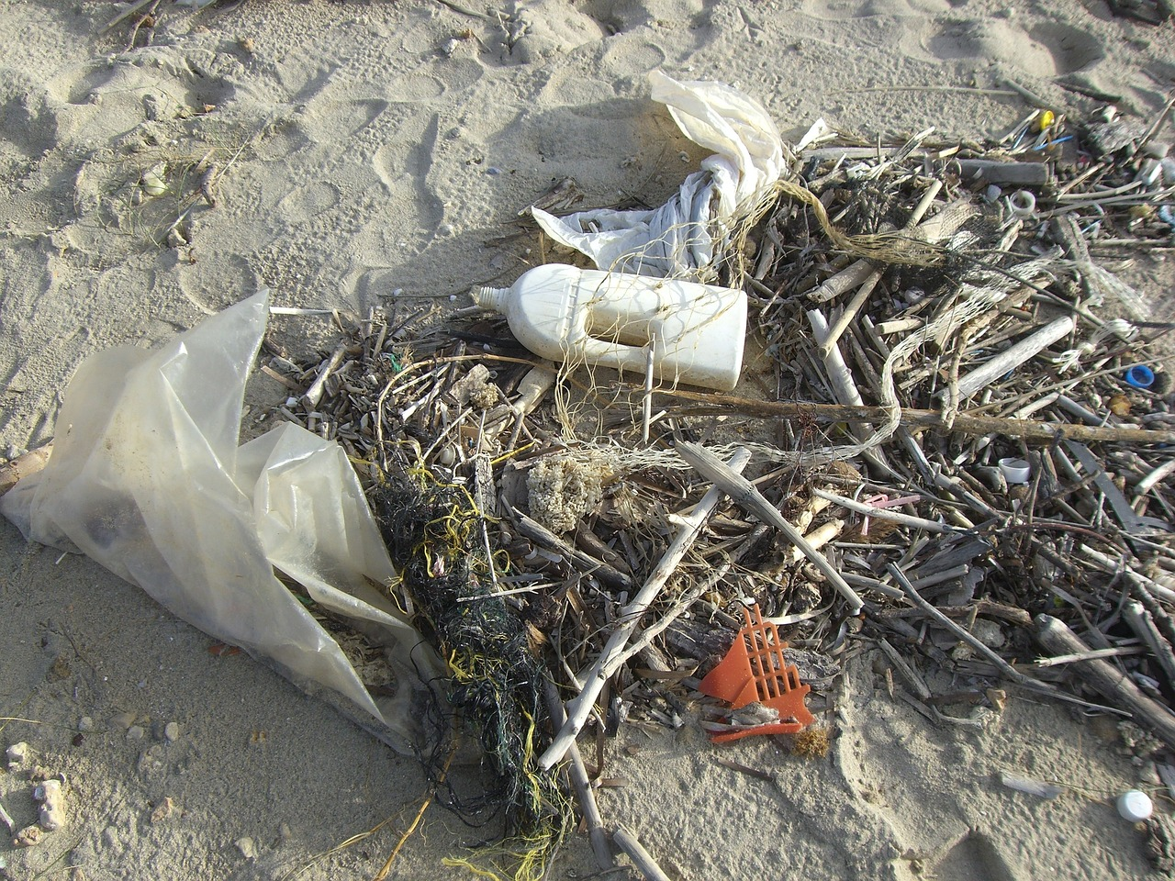
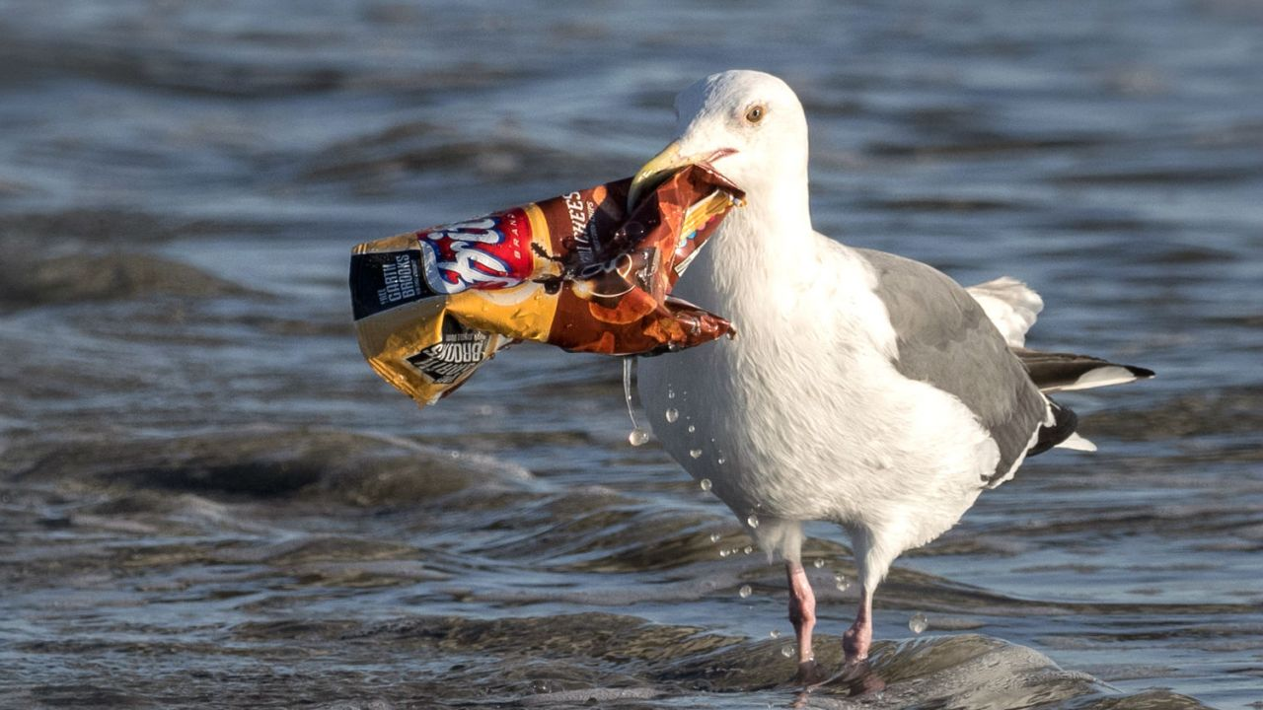
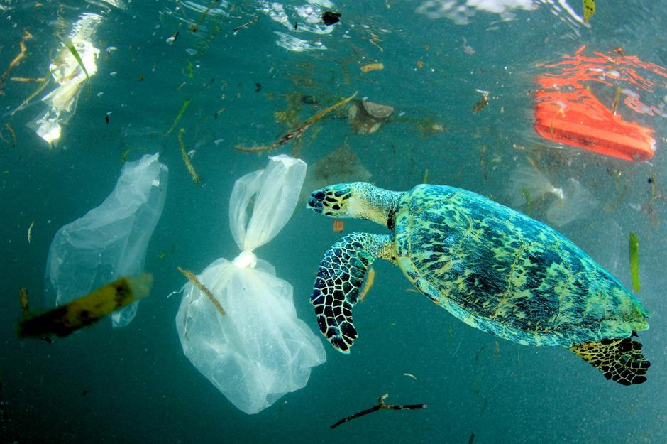
Here are some pictures of how plastic pollution puts an impact in the environment

Slide 4
Basic idea of our web application
An app that will aid people on how to be eco-friendly.
There will be links of stores that sells recyclable and plastic free products, such as, cutleries, paper cups and etc.
People can join or generate campaigns to create awareness on reduction of plastic consumption.
Users can publish or read papers regarding plastic consumption via our app.
Lastly, they can aware humans by sharing awareness posts on plastic consumption on social media platforms.

Slide 5
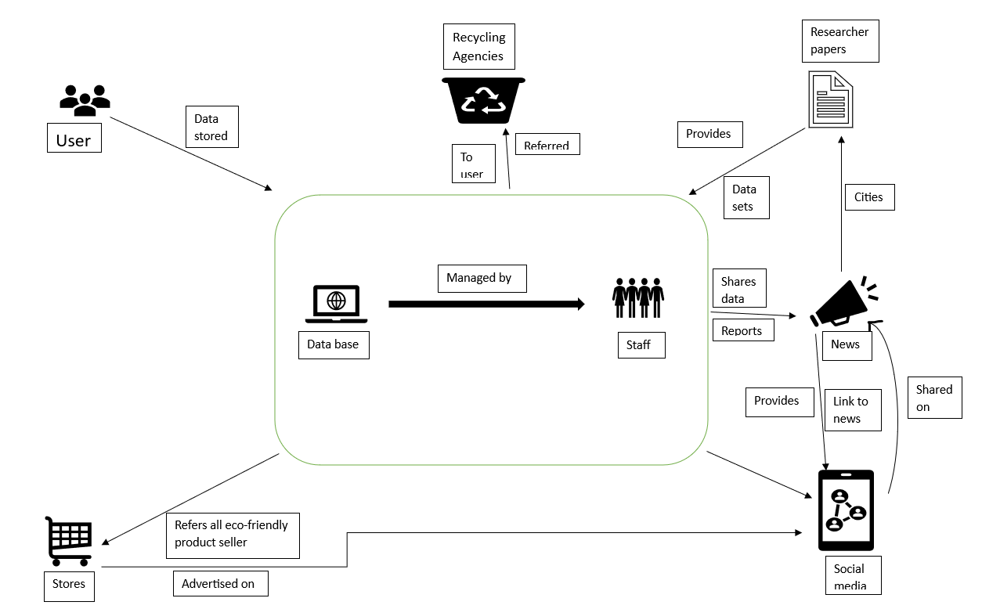
In order to visualize our concept of reducing plastic consumption, the following Rich Pictures have been prepared:
Fig: Rick Picture AS IS.

Slide 6
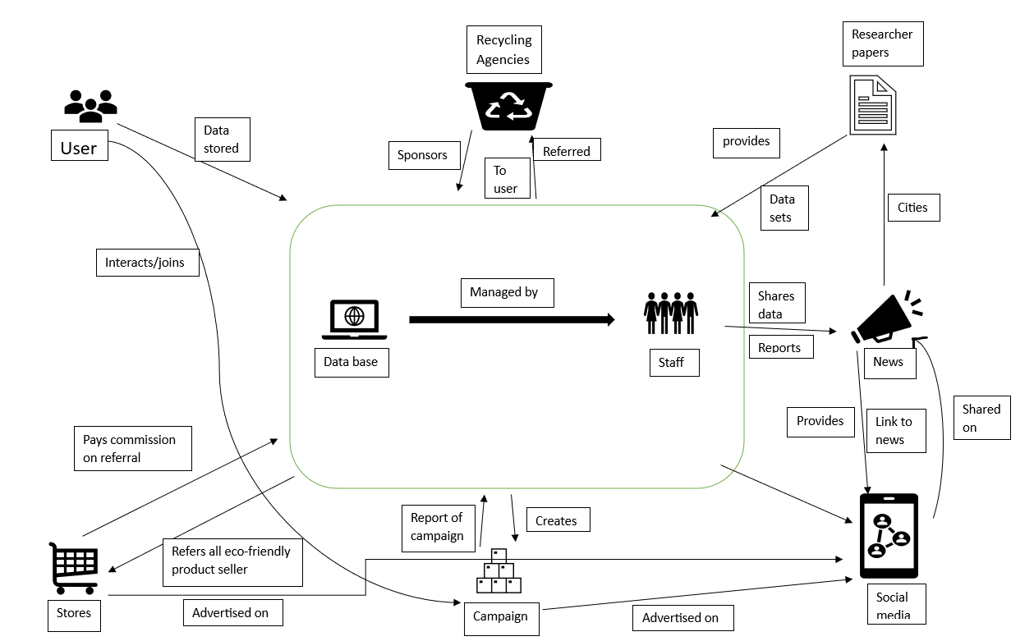
Fig: Rick Picture TO BE.

Slide 7
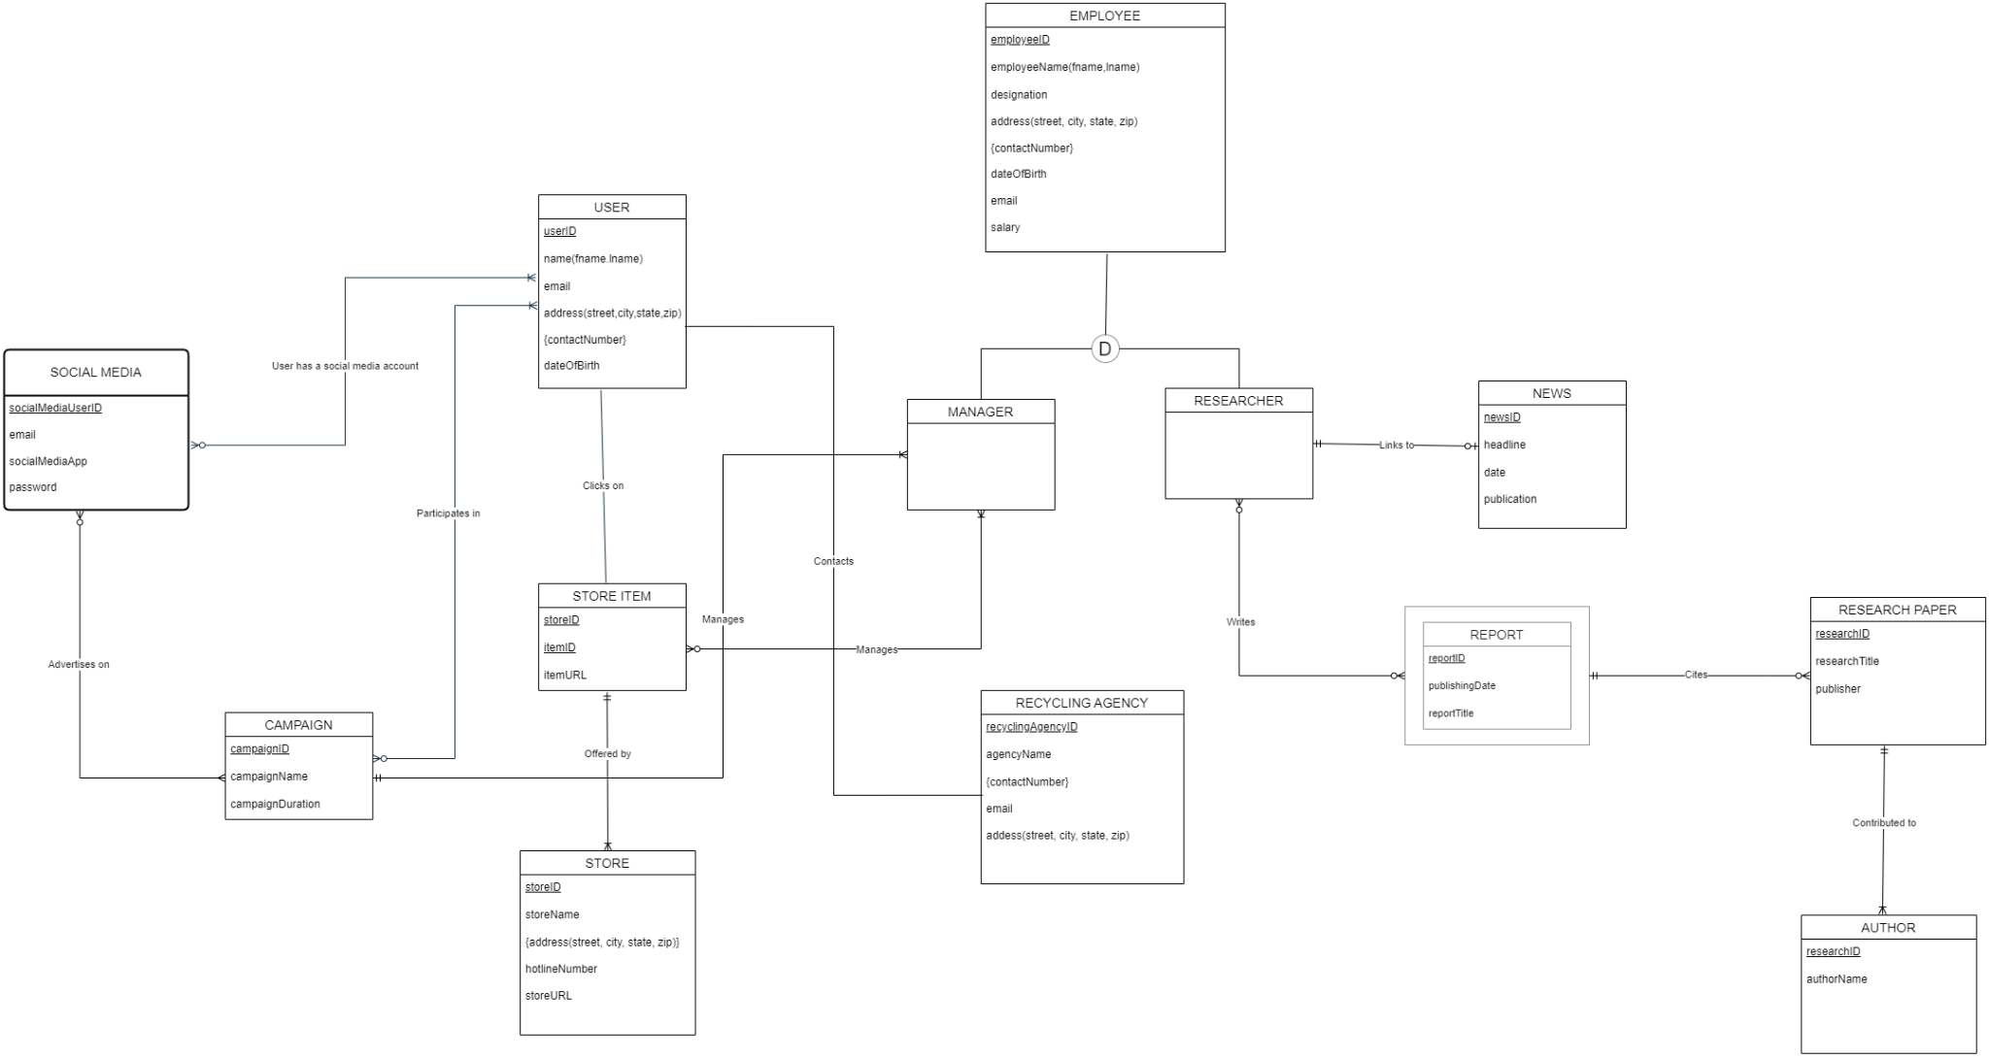
The Enhanced Entity diagram here provides the visual representation of the relationships:

Slide 8
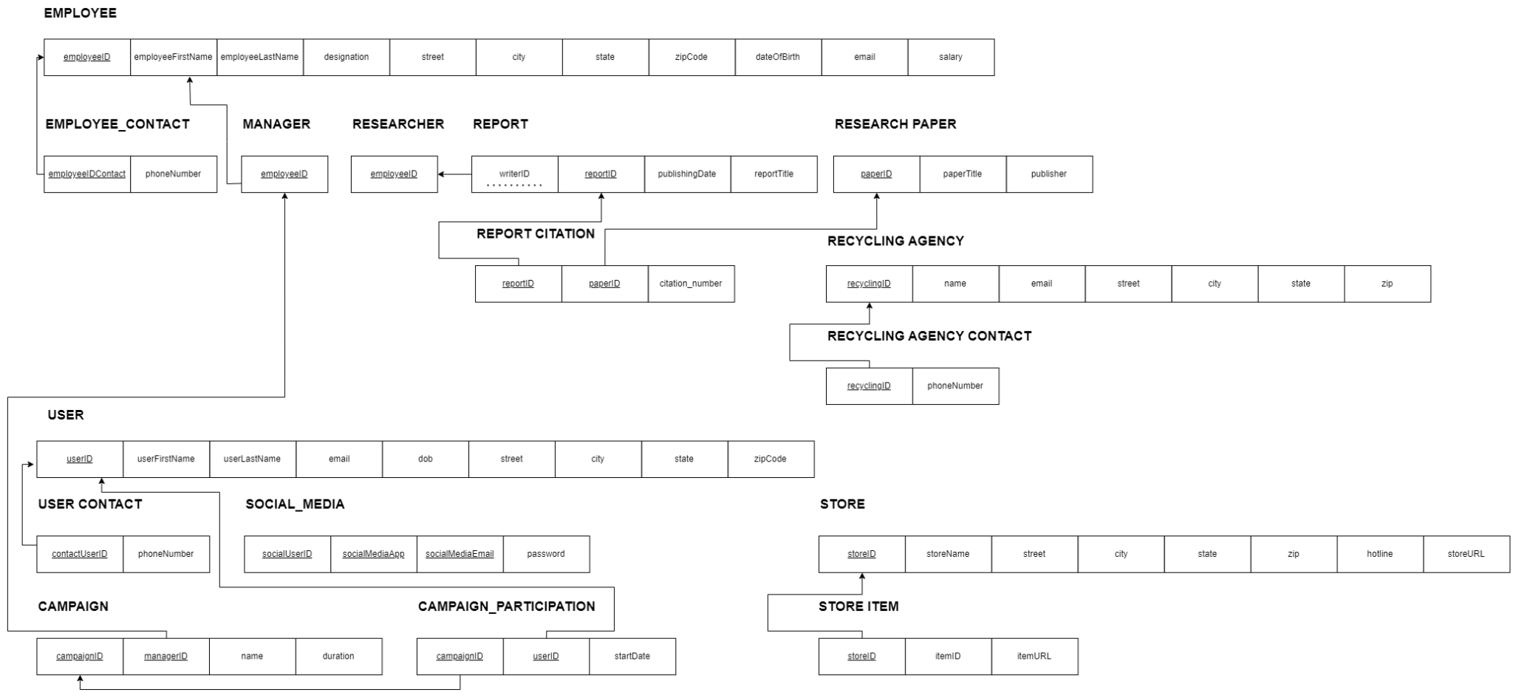
For better understanding we converted the EERD into Relationship Schema:

Slide 9
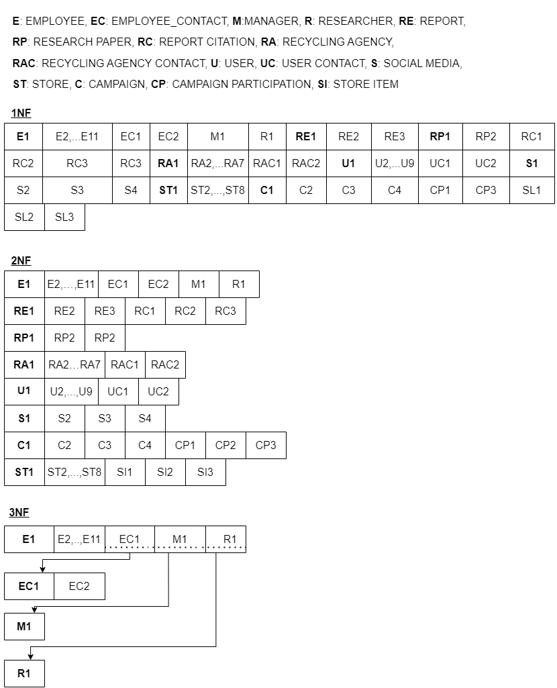
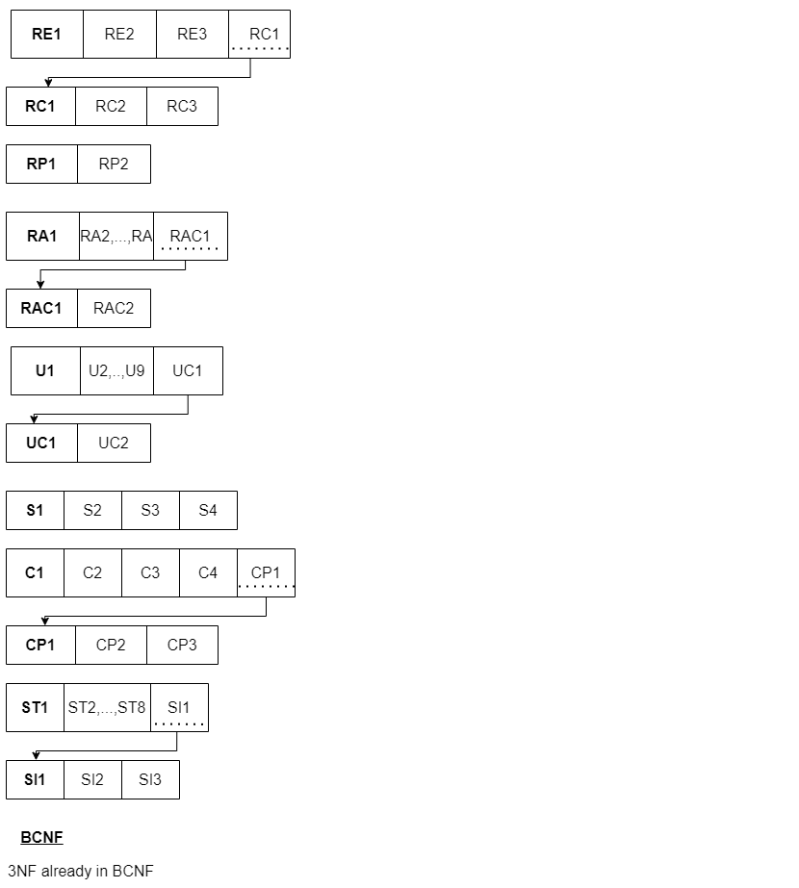
Here is the normalized Relationship Schema:

Slide 10
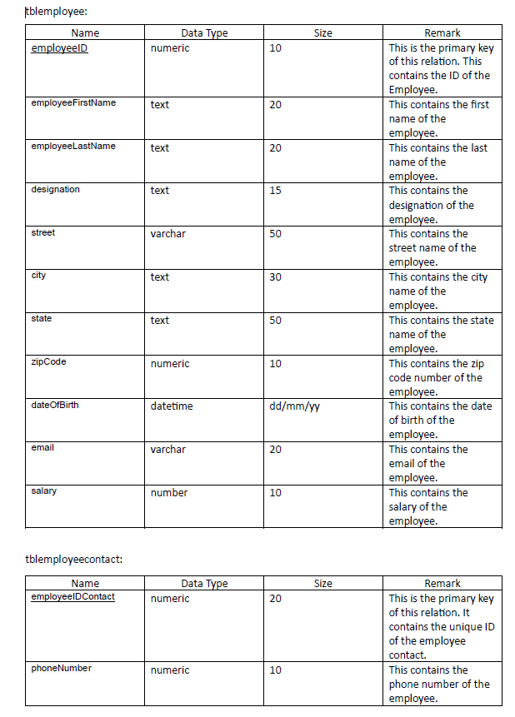
Data table:

Slide 11
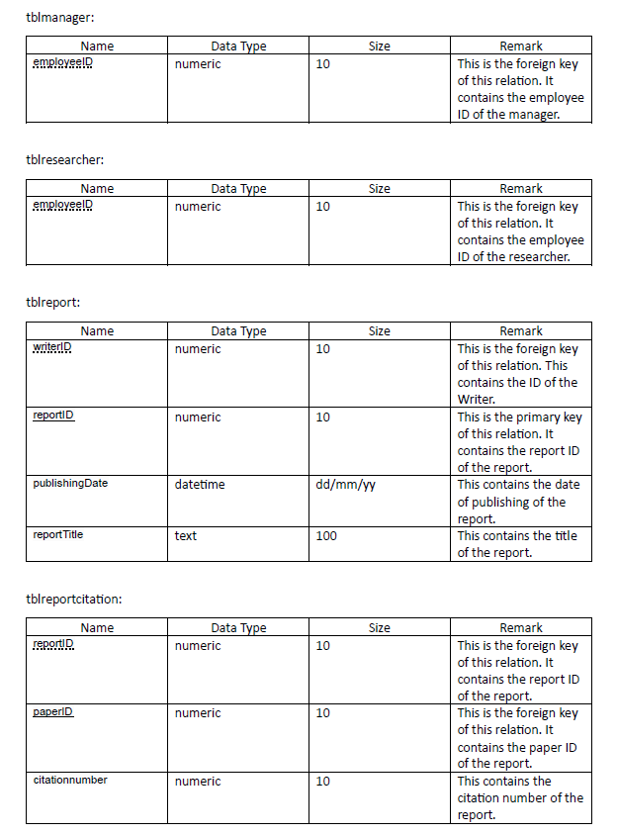

Slide 12
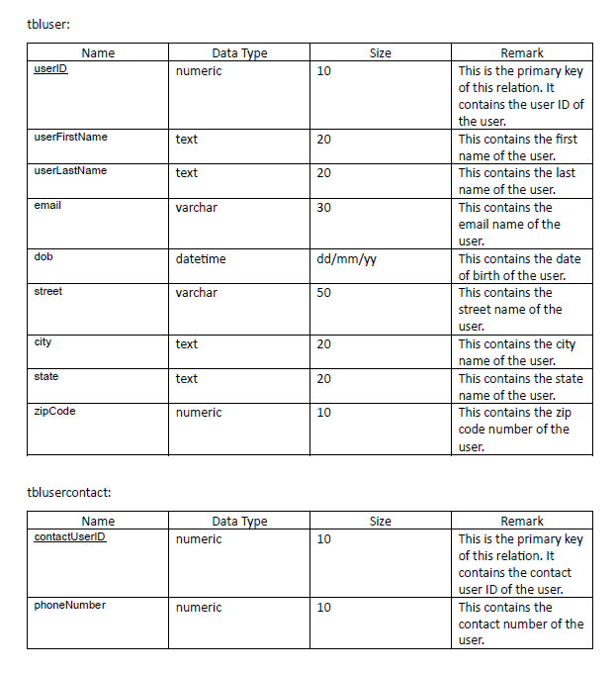

Slide 13
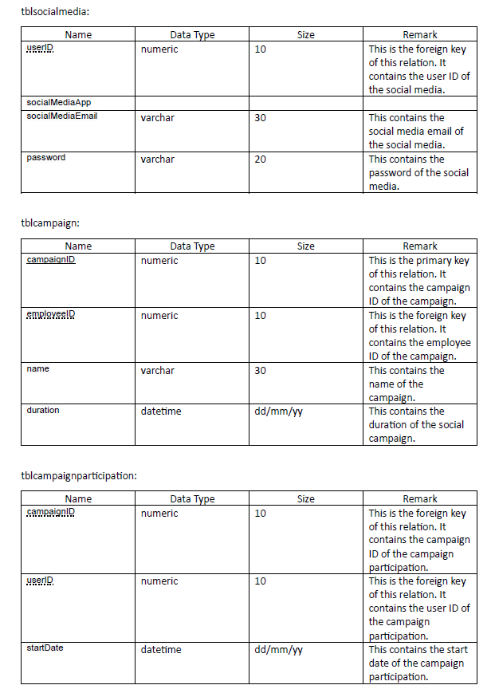

Slide 14
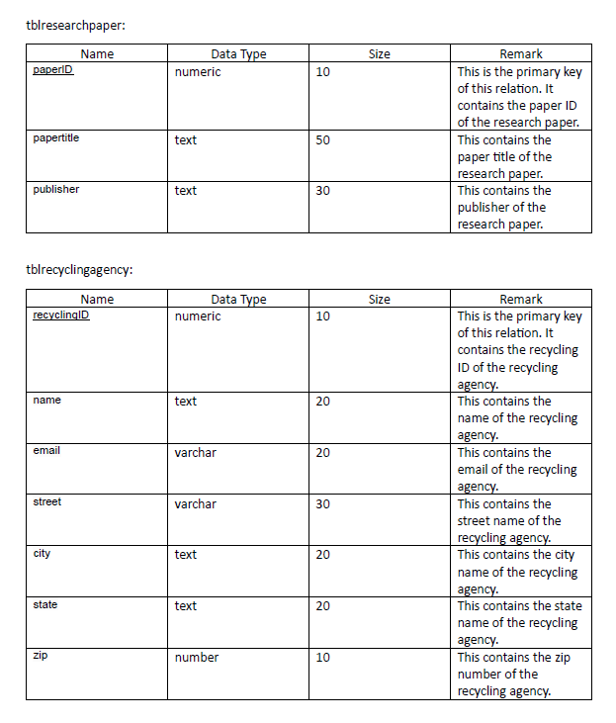

Slide 15
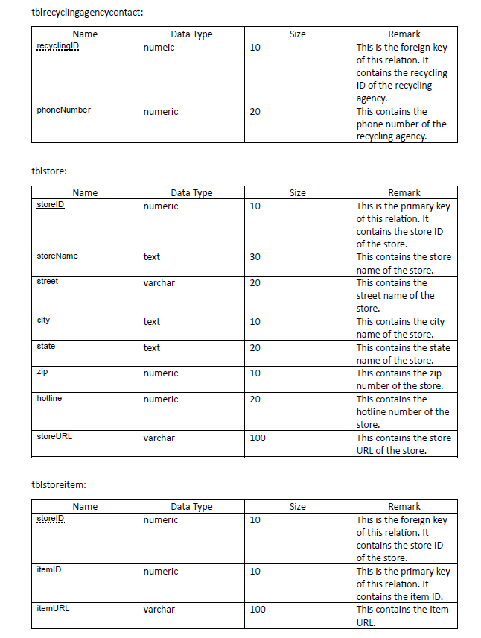

Slide 16
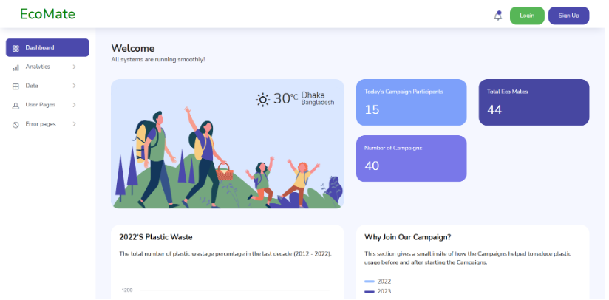
Some of the works in the frontend we have done so far:

Slide 17
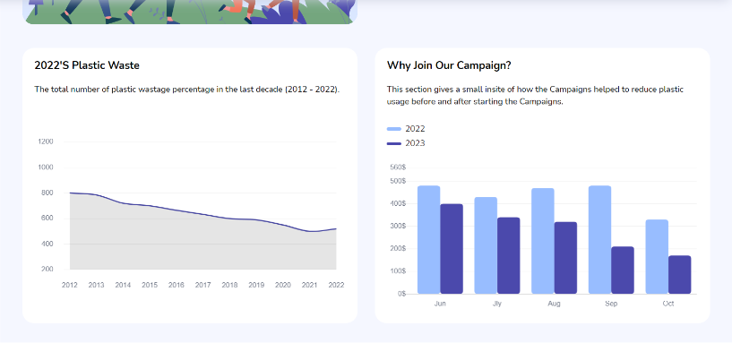
Some of the works in the frontend we have done so far:

Slide 18
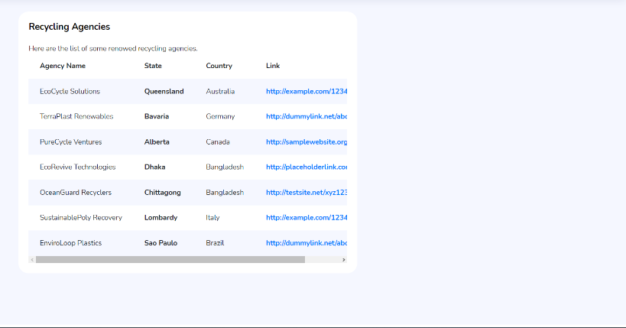
Some of the works in the frontend we have done so far:

Slide 19
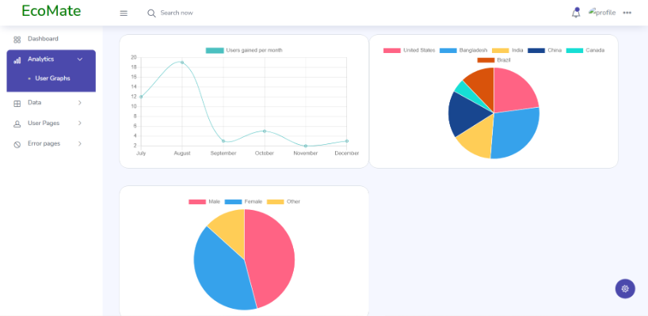
Some of the works in the frontend we have done so far:

Slide 20
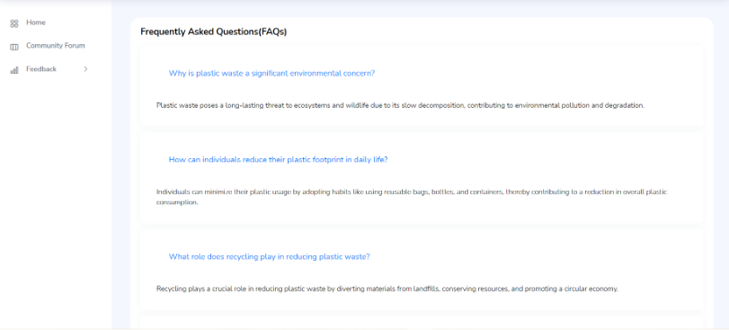
Some of the works in the frontend we have done so far:

Slide 21
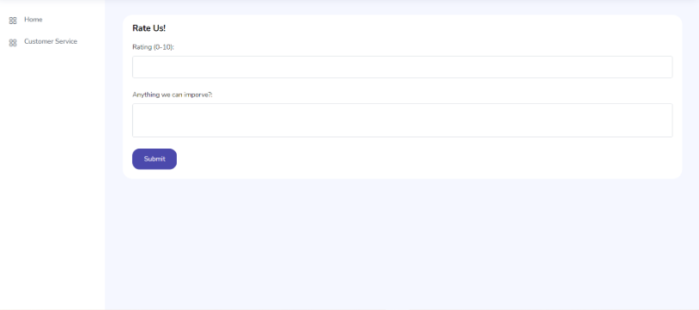
Some of the works in the frontend we have done so far:

Slide 22
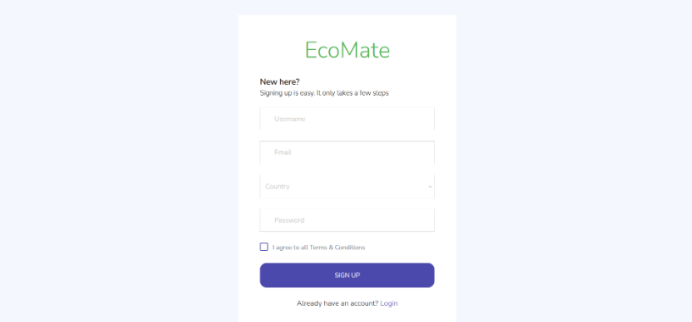
Some of the works in the frontend we have done so far:

Slide 23
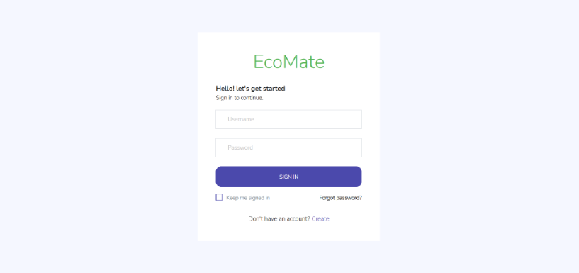
Some of the works in the frontend we have done so far:

Slide 24
Thank you for your time 😊

